Slide 1
Intelligence

Slide 2
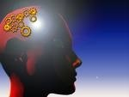
Intelligence
“Capacity to understand the world, think rationally, and use resources efficiently when faced with challenges.”
(Wechsler, 1975)
“Intelligence is a very general mental capability that, among other things involves the ability to reason, plan, solve ideas, problems, think abstractly, comprehend complex ideas, learn quickly and learn from experience.”

Slide 3
Factor Theories of Intelligence
Primary interest of these theories is to identify the factor or factors which make up Intelligence.
Main Debate is Single factor/collection
G factor by Spearman- Each intellectual task taps a general mental ability
Multifactor theory by Thurston-Primary Mental Abilities
Hierarchical Theory- Like a pyramid

Slide 4
G factor by Spearman
A broad general factor
Different cognitive Tasks and Intellectual measures are correlated
Reflected in Intelligence tests which give one score
Multifactor Theory by Thurstone
Verbal comprehension
Word Fluency
Perceptual speed
Memory
Numerical Ability
Spatial Ability
Reasoning

Slide 5
Guilford-3 Dimensional Theory or Structure of intellect
150 factors of intelligence
Each factor is represented as cube-3 dimensions
Operations
Products
Contents
Hierarchical Theory-Vernon
G factor
S S S several Moderately Specific Abilities
S S S
Highly Specific

Slide 6
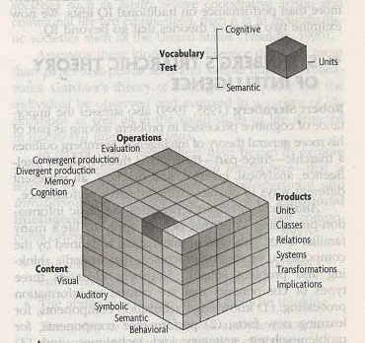
Guilford’s model

Slide 7
Process Oriented Theories
Patterns of thinking people use, how people solve problems
Piaget’s Theory
An adaptive process which involves an interplay of biological maturation and environment
Bruner’s Theory
Intellectual development as internal representation
Role of reward and punishment
Information Processing Theory-
Take information, break it down and use it to reason and solve problems

Slide 8
Sternberg’s Triarchic theory of Intelligence
Stresses on the importance of cognitive processes in problem solving.
3 types of intelligence- Analytical, Creative & Practical; related to effective performance.
Analytical- involves ability to think critically and analytically, provides basic information processing skills that people apply to life’s many familiar tasks.
Knowledge acquisition.
Excel in academic tests

Slide 9
Creative Intelligence- emphasizes ability to formulate new ideas.
Person’s who rate high on this dimension excel in zeroing in on what information is crucial a given situation and combining seemingly unrelated information.
Many scientific geniuses and inventors.

Slide 10
Practical or contextual Intelligence- management of day to day affairs.
  Street smarts.
  Adept at solving problems of everyday life. Intelligent in a practical adaptive sense.
  Different from what is required for success in school.

Slide 11
Gardner’s multiple intelligences
Most definitions based on normal children and adults.
Gardner argued to study extremes-geniuses and those with impaired cognitive functioning.
Numerous abilities that cover a range of human experience however different abilities preferred across different cultures.

Slide 12
Gardner’s eight intelligences
Intelligence | End States | Core components
Logical mathematical | Scientist mathematician | Sensitivity & capacity to discern, logical or numerical patterns; ability to handle long chains of reasoning
Linguistic | Poet | Sensitivity to sounds meanings of words; sensitivity to different functions of language
Naturalist | Biologist/ Environmentalist | Sensitivity to differences among diverse species, abilities to interact subtly with living creatures
Musical | Composer /Violinist | Ability to produce & appreciate rhythm, pitch, and timbre; appreciativeness of the forms of musical expressiveness
Spatial | Navigator/ Sculptor | Capacities to perceive the visual-spatial world accurately and to perform transformations on one’s initial perceptions.
Bodily Kinesthetic | Dancer; athlete | Ability to control one’s body movements and to handle objects skillfully
Interpersonal | Therapist | Capacities to discern and respond appropriately to moods, temperaments, motivations of others
Intrapersonal | Person with accurate self-knowledge | Access to one’s own feelings and ability to discriminate among them and draw upon them to guide behavior

Slide 13
Emotional Intelligence
Self -Awareness: being aware of what you’re feeling
Self- Management: ability to manage one’s own emotions and impulses
Self-motivation: ability to persist in the face of setbacks and failures
Empathy: ability to sense how others feel
Social Skills: ability to handle the emotions of others
Similar to Gardner’s idea of interpersonal and intrapersonal intelligence.

Slide 14
Two Kinds of Intelligence by Cattell
Fluid Intelligence
Ability to think and reason, see complex relationships and solve problems; measured by tests of block designs & spatial visualization in which the background info needed to solve a problem is readily apparent.
Crystallized Intelligence
Knowledge one has already acquired and stored over a lifetime.
Helps you cope with life’s recurring problems.
Fluid intelligence may decline with age and those loses may be offset by vast store of knowledge in crystallized intelligence.

Slide 15
Assessing Intelligence
Binet-Simon initially started to identify mental retarded children in French Schools
1916 Lewis Terman
Test is by age levels
Tasks according to each age level
Test Performance is the Mental Age
IQ = MA/CA × 100 (William Stern, 1912)

Slide 16
Wechsler Tests
Family of Tests(Wechsler Adult Intelligence Scale, revised , 1981, Wechsler Intelligence scale for children, revised)
Can be used at different age groups
Verbal and performance subtests
Verbal subtests- Information, Comprehension, Arithmetic, Similarities, Digit Span, Vocabulary
Performance- digital symbol-coding, picture completion, block design, picture arrangement, object assembly
Verbal-may be limiting
Performance- can be used in case of brain damage etc.
Deviation IQ= X-M/SD
Mean= 100, SD=15

Slide 17
IQ Distribution for a test with SD 15
130 and above | Very Superior | 2.2
120-129 | Superior | 6.7
110-119 | Bright Normal | 16.1
85-109 | Average | 59.1
70-84 | Borderline | 13.6
55-69 | Mildly mentally retarded | 2.1
40-54 | Moderately mentally retarded | 0.1
25-39 | Severely mentally retarded | 0.003
Below 25 | Profound mentally retarded | 0.0000005

Slide 18
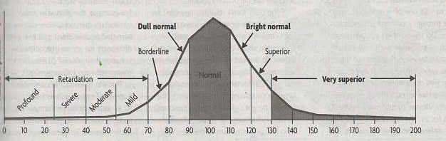

Slide 19
Process oriented Assessment
Uzgiris and Hunt(1975)
Six developmental scales measuring progressive levels of cognitive development.
Focus on where an infant lies within a particular sequence of development
Does not compare how one infant does versus other babies of the same age.
Useful with handicapped children

Slide 20
Achievement Test-
A test intended to determine a person’s level knowledge in a given area
Aptitude Test-
A test designed to predict ability in a particular area line of work

Slide 21
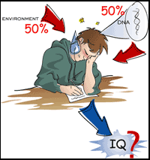
Genetic and Environmental Influences
Studies of Identical and fraternal twins in
Britain, France, Finland etc does show
considerable genetic influence
Children’s IQ correlated with
biological parents
Studies of Identical twins, siblings and
unrelated pairs correspond more closely
on IQ when reared together.
Extremely poor rearing conditions-Low IQ
Enriched rearing- High IQ

Slide 22
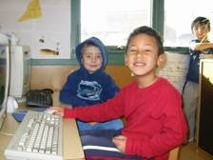
Group differences in Intelligence
Gender differences
Overall IQs of males and females at any age are virtually same
Home environment
Racial differences
Some groups live, work and raise children in circumstances much more conducive
to intellectual environment

Slide 23
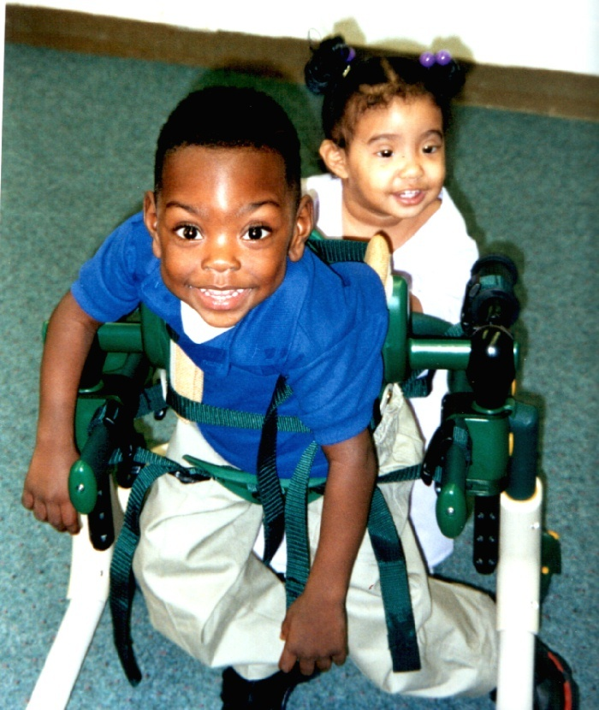
Mental Retardation
They attain IQs below 70
Adaptation skills are inadequate to cope with ordinary daily tasks
Causes
Involving IQ above 50 (between 50-70)is
cultural-familial socio cultural retardation
when at least one parent is retarded.
Environmental causes
Illness of a pregnant women
Injury to the brain infancy or at the
time of birth

Slide 24
Intellectual Development
Retarded people pass through the stages at a slower pace and cease developing at a lower stage than most of us.
Current emphasis on adaptive skills has prompted experts to abandon that terminology in favor of “ a person with mental retardation with extensive supports needed in the areas of social skills and self-direction.” or a person with mental retardation who needs limited supports in communication and social skills.”
Retarded youngsters are
Generally passive
Dependent on others for solution
Failure reinforces this
Education and Training
Special Training can sometimes produce modest changes in IQ and adaptive behaviors.

Slide 25
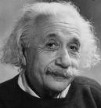
Intellectually Gifted
Have IQ scores greater than 130
IQs above 145 are rare indeed 1/1000
A moderately bright child “star” of the class
May also be a misfit, misunderstood
Study by Lewis Terman(1925)-high IQ children(140 and above) were quite well adjusted however Hollingsworth (1942) found children with IQ above 180 very poorly adjusted.
  Out of sync with their peers.
  However, things get better as they mature, they get better at findings settings where their abilities are an asset.
  Hence, may be better adjusted and happier.

